Slide 1
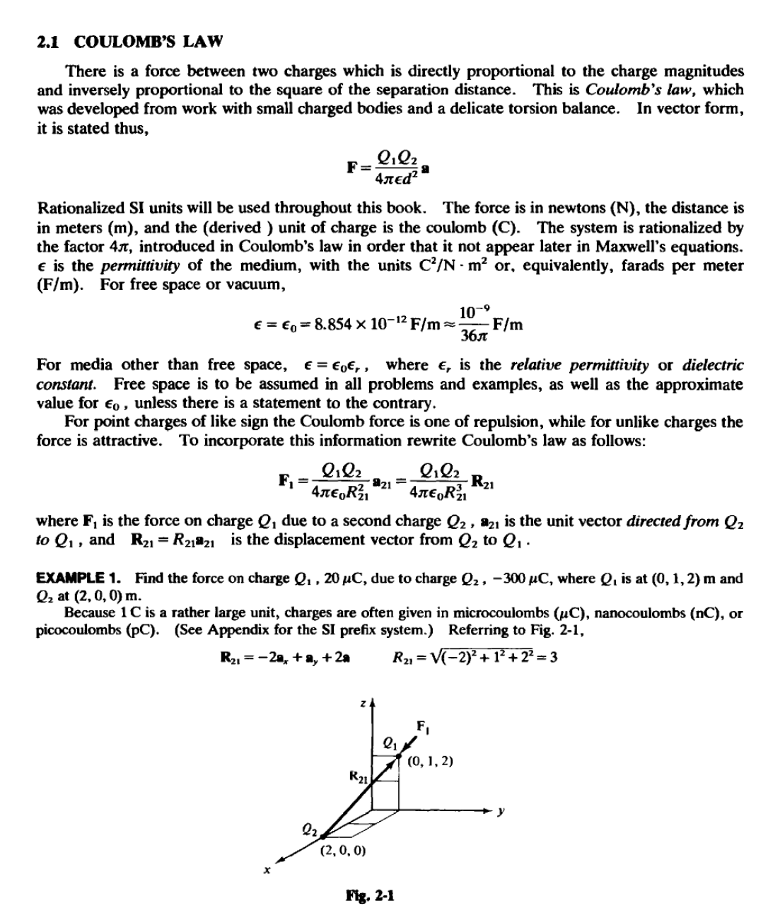
Lecture two/ Coulomb force & Electric field intensity

Slide 2

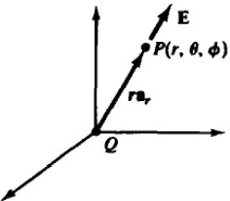
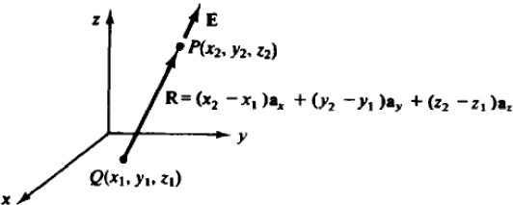
and
az, -3¹(- +-,. +2a.)
'-(20 )( 10- }(- 300 )( 10(-2a.. +.,+2a.)
Tben
6
I 4Jr(J0-⁹/361f){3)¹ 3
.. 2a.- i-2a.)N
1be force mqnitude 1$ 6N and the direction is such that Q₁is attracted to Qz (unlike charges attract).
This force relationship is bilinear in the charges. Consequently, superposition applies, and the
force on a charge a.due ton- 1other charges Q2 .QJ •...• Q,. is the vector sum of the individual
forces:
Q.Qz Q.Q3
Q, a.
F, =
2.
+
2 •J• +···=-- £J -2- llett
4JrEoR2J 4JrEoRJt
4JrEo 11•2R,tl
This superposition extends in a natural way to the case where charge is continuously distributed through some spatial region: one simply replaces the above vector sum by a vector integral (see Section 2.3).
Tbe force field in the region of an isolated charge Q is spherically symmetric. This is made evident by locating Q at the origin of a spherical coordinate system, so that the position vector R, from Q to a small test charge Q,«Q, is simply ra,. . Then
showing that on the spherical surface r =constant, IF,I is constant, and F, is radial.
U ELECI'RIC FIELD INTENSITY
Suppose that the above-considered test charge Q, is sufficiently small so as not to disturb sipificantly the field of the fixed point charge Q. Then the ekctric field intmsily, E, due to Q is defined to be the force per unit charge on Q,: E =F,/Q, .
For Q at the origin of a spherical coordinate system [see Fig. 2-2(.a)], the electric field intensity at an arbitrary point Pis, from Section 2.1,
Q
E=--a,
4JrEo?
(a) Spherical
(b) Cartesian

Slide 3

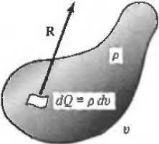
ln an arbitrary cartesian coordinate system [see Fig. 2-2(b)],
E=
Q
4nt:uRz
aR
The units of E are newtons per coulomb (N/C) or the equivalent, volts per meter (V/m).
EXAMPLE 2. Find Eat (0, 3, 4) m in cartesian coordinates due to a point charge Q = 0.5 fJC at the origin.
In this case
R = Ja,. + 4a, R = 5 aR = 0.6a,. + 0.8a.
o.5 x w-"
E 4Jr(10-ll/36n:)(W (0.6a,. + 0.8a,)
Thus lEI = 180V/m in the direction aR = 0.6a, +0.8 a, .
2.3 CHARGE DISTRIBUTIONS
Volume Charge
When charge is distributed throughout a specified volume , eacb charge element contributes to the electric field at an external point. A summation or integration is then required to obtain the total electric field . Even though electric charge in its smallest division is found to be an electron or proton, it is useful to consider continuous (in fact, differentiable) charge distributions and to define a charge density by
dQ
p =­
dv
Note the units in parentheses , which is meant to signify that p wi l be in C/m³ provided that the variables are expressed in proper Sl units (C for Q and m³ for v). This convention will be used throughout this book.
With reference to volume v in Fig. 2-3, each differential charge dQ produce s a differential
electric field
p I dE
•
Fig. 2·3
at the observation point P. Assuming that the only charge in the region is contained within the volume, the total electric field at Pis obtained by integration over the volume:
E= J paR dv
v 41r£oR 2

Slide 4
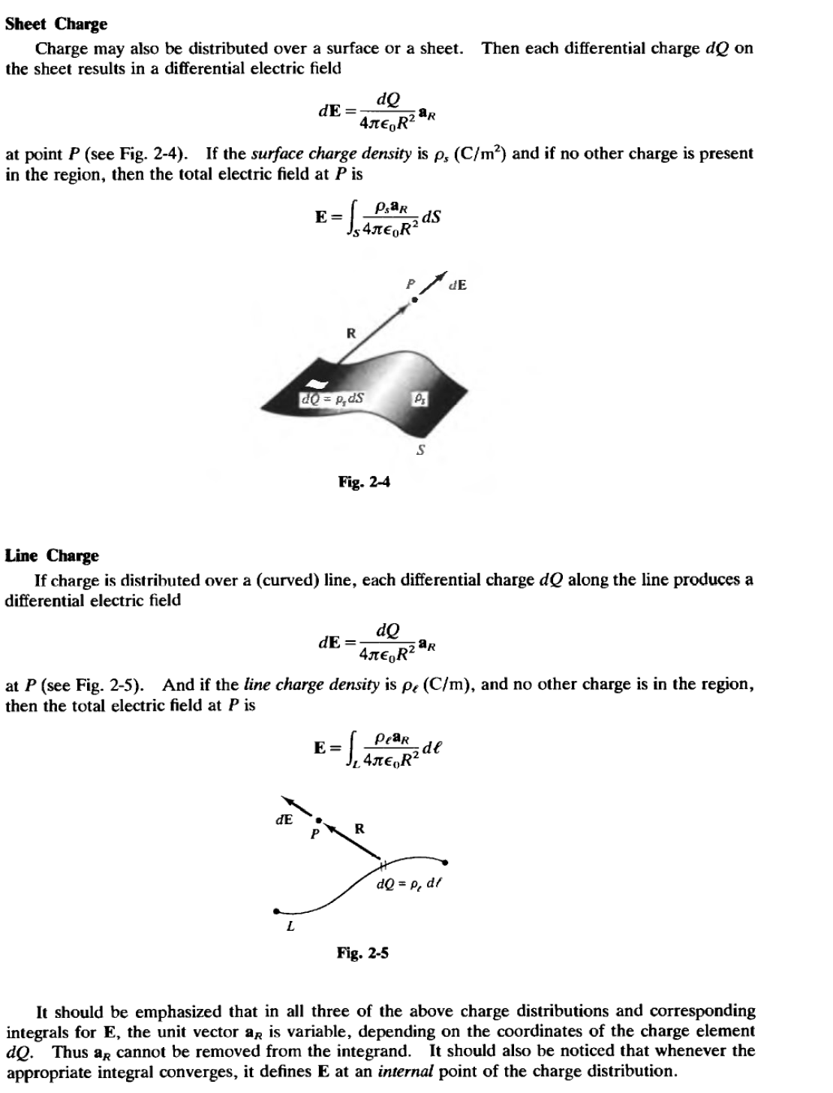

Slide 5

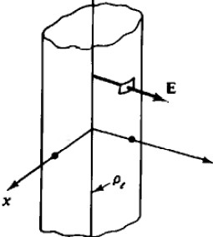
2.4 STANDARD CHARGE CONFIGURATIONS
In three special cases the integration discussed in Section 2.3 is either unnecessary or easily carried out. In regard to these standard configurations (and to others which will be covered in this chapter) it should be noted that the charge is not "on a conductor." When a problem states that charge is distributed in the form of a disk, for example, it does not mean a disk-shaped conductor with charge on the surface. (In Chapter 6, conductors with surface charge will be examined.) Although it may now require a stretch of the imagination, these charges should be thought of as somehow suspended in space, fixed in the specified configuration.
Polae Clwp
As previously determined, the field of a single point charge Q is given by
E= lL_ 11r
(spherical coordinates)
4nE₀r2
See Fig. 2-2(a). This is a spherically symmetric field that follows an inverse-square law (like gravitation) .
ldalte LiDe Cbarle
Hcharge is distributed with uniform density p, (C/m) along an injiniiL, straight line-which will be chosen as the z axis-then the field is given by
(cylindrical coordinates)
See Fig. 2-6. This field has cylindrical symmetry and is inversely proportional to the first power of
the distance from the line charge. For a derivation of E, see Problem 2.9.
+oo
y
-
EXAMPLE 3. A uniform line charge, infinite in extent, with p, s20 nC/m, lies along the z axis.
(6,8,3)m.
In cylindrical coordinates r = V6² + 8² = 10m. The field is constant with z. Thus
20 x to-⁹
E"" 2Jr(10-9/36Jr)(l0)-. = 36a, V/m
Find E at

Slide 6
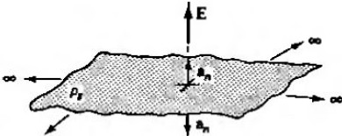
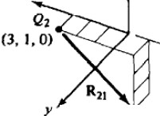
ldaite Plue Cbarp
If charge is distributed with uniform density p, (C/m ) over an infinite plm&e, then the field is
given by
E=_&•
2E"o "
See Fig. 2-7. This field is of constant magnitude and has mirror symmetry about the plane
charge. For a derivation of this expression, see Problem 2.12.
..
I
E
fla.l-7
EXAMPLE 4. Charge
(1/3n) nC/m²
is distributed
uniformly over the plane z = 10em with a density p, •
Find E.
p, (l/3n)10-⁹
lEI= Z£o =₂(₁₀_9/36Jr) =6 V/m
Above the sheet (z > 10em),
E = 68, V/m;
and for z < 10em, E = -6e, V/m .
Solved Problems
%.1.
Two point charges, Q₁=50iJC and Q₂ = lOiJC, are located
(3, l,0) m, respectively (Fig. 2-8). Find the force on Q₁•
R2, =-4a, -Ja,
at (-1,1, -3)m and
-4a -3a
.1:1 = :a z
5
Q,Q2
F, = 4 L R2 llzt
1f"'o 21
,(50 x 10-")(10-⁵ (-4a,.-3a,)
)
4n(10 "/36n)(S) S
2
:s (0.18)(-O.Sa.-0.6e,) N
z
X
Ql (-1,1.-3)
FJa.l-1

Slide 7
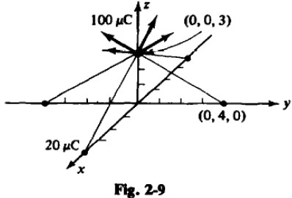
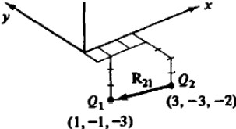

The force bas a magnitude of 0.18 N and a direction given by the unit vector -o.s._ -0.c... In component form,
F₁•0.14411.-0.108a. N
2.2.
Refer to Fig. 2-9. Find the force on a tOO f.'C charge at (0,0,3) m if four like charges of 20 JAC are located on the x and y axes at ±4 m.
Consider the force due to the charge at y =4,
(10-⁴)(20 x to- (-4a, + .)
4Jr(10-⁹/36n)(S)² S
1be y component wiU be canceled by the charge at y - -4. Similarly, the x components due to the
other two charges wiU cancel. Hence
F=4 )G··) = 1.73a. N
Refer to Fig. 2-10. Point charge Q₁= 300 JAC, located at (1, -1, -3) m, experiences a force
1.3.
%
,...2-tt
due to point charge Q₂ at (3, -3, -2) m. Determine Q₂•
R:z• "" -28. +2a,.- a.
Note that, because

Slide 8
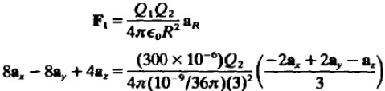
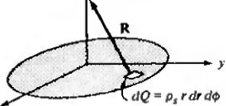


Solving, Q₂ = -40 JJC.
1.4.
Find the force on a point charge of SO pC at (0, 0, 5) m due to a charge of SOOn pC that uniformly distributed over the circular disk r :sS m, z = 0m (see Fig. 2-11).
:r
(0, 0, S)
X
...... Z.ll
1be charge density is
In cylindrical coordinates,
R = -ra, +58,
Then each differential charge results in a differential force
dF = (50 x 10-⁶)(p.r dr df/>) (-r r +Sa,) 4n(10-⁹/36.7r)(r² +25) Vr'i +25
F= iu.is (50 x 10- (0.2 x to-•)sr dr d
Before integrating , note that the radial components will cancel and that a. is constant. Hence
•1.5•
4n(10-⁹/36Jr)(r² +25)3/Z a,
Repeat Problem 2.4 for a disk of radius 2m.
Reducing the radius has two effects:the charge density is increased by a factor
Pz = (5)2 -6 25
p, (2)2 .
while the integral over r becomes
₁(r2 +2S)ll2 = 0.0143
L (,Z +25)3/Z = 0.0586
2
rdr
instead of
s rdr
1be resulting force is
F= (6.25) ^{0.}_⁰¹⁴³⁾(16.5611,N)::25.27•, N
⁽0 0586

